Slide 1

Project #2
Ashley Ridley and Thomas Mackin

Slide 2
Building Blocks
Def
While
True
If
In
Elif
Else
Print
Return
And
For
Ord

Slide 3
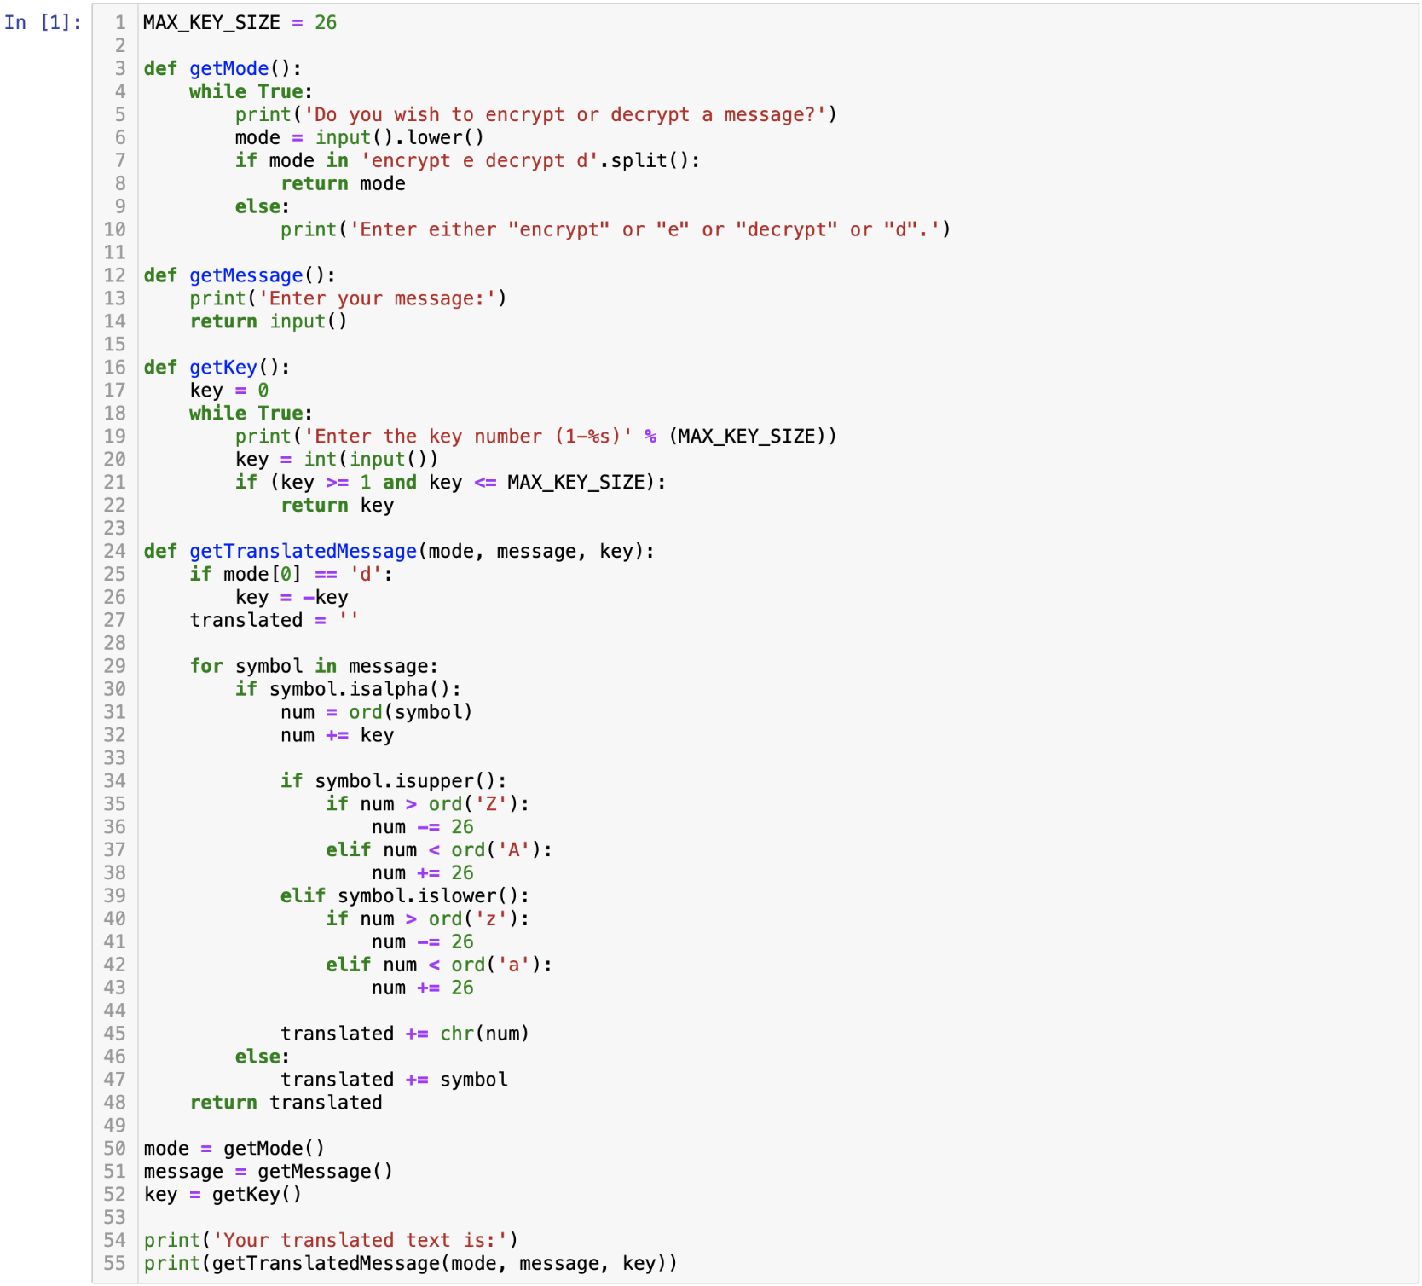

Slide 4
